Slide 1

WEEK 1 · INCIDENT RESPONSE LAB
Event To Incident [Threat Intel]
From Security Event to Confirmed Incident
Event Triage · Incident Classification · Threat Intelligence Validation
Hands-on lab
Scenario: phishing email artifact analysis (Email.eml)
Analyst Fundamentals
Week 1 Lab

Slide 2
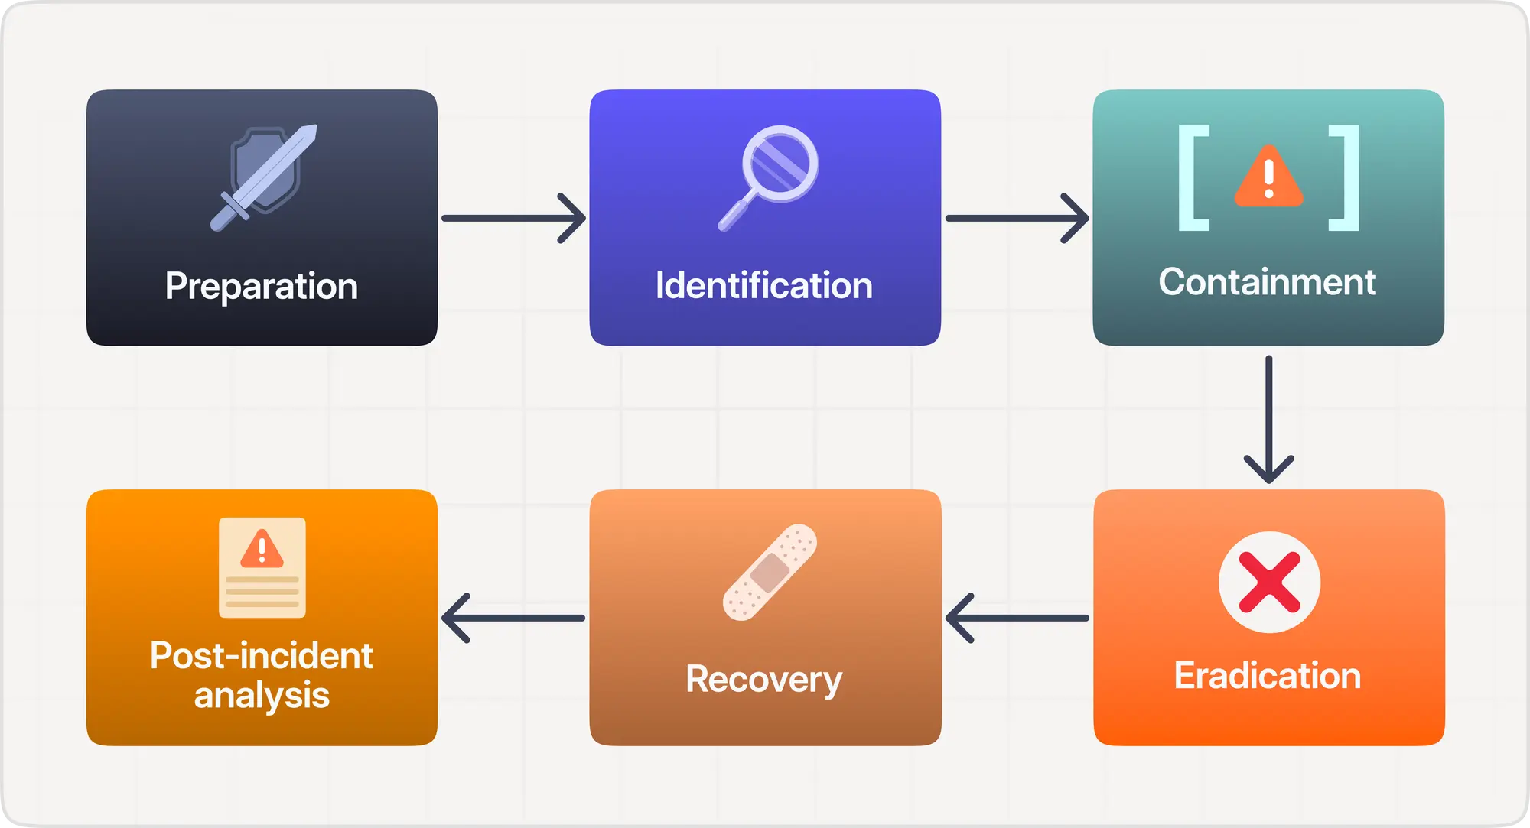
Incident Response Lifecycle (NIST)
NIST stands for the National Standards and Technology Institute. Here are NIST incident response phases:
Week 1 Lab

Slide 3
Why This Matters In Industry
Junior analysts rarely fail from a lack of tools. They fail from not knowing what to do first.
1
What happened?
2
Who or what is affected?
3
What evidence do we have?
4
What evidence is missing?
5
Event, suspicious activity, or confirmed incident?
6
Which indicators are worth acting on?
7
What should be contained first?
Threat intel lens: never trust an IoC blindly — compare internal observations against provided intelligence and judge relevance, age, and confidence.
Week 1 Lab

Slide 4


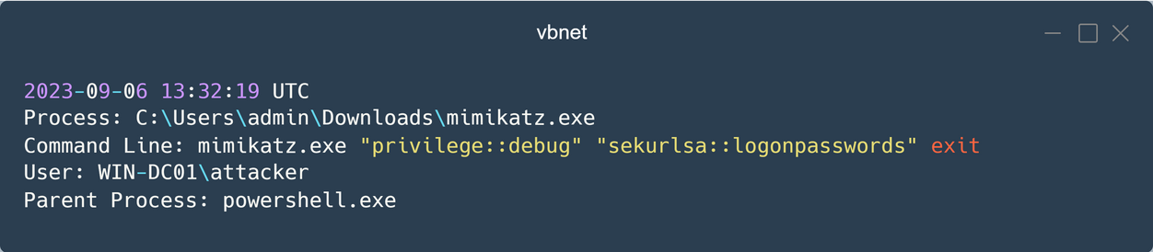
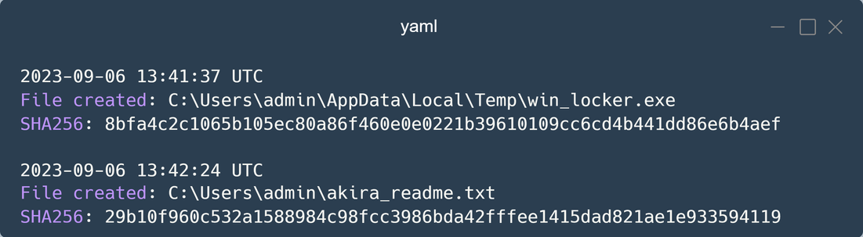
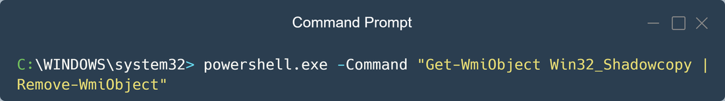
INDICATOR OF ATTACK
INDICATOR OF COMROMISED
IOA
Detecting the intention of the attacker whether it has gained or attempting to gain access to the environment.
Unexpected file or processes, registry changes or configuration changes & unusual pattern of network traffic
IOC
Evidence that a malicious entity has successfully gained access to the environment.
Hash value, IP addresses, Signatures, Vulnerability exploitation
EXAMPLE
EXAMPLE

Slide 5
Example
Your task is to extract information regarding this file:
f526a8ea744a8c5051deefbf2c6010af
What to extract?
IOC
IOA
Name of the malware?
What does this malware?
Targeted on what platform?
Week 1 Lab

Slide 6
Scenario Context
You are the cybersecurity analyst on duty.
QUICK FACTS
As a cybersecurity analyst at an educational institution, you receive an alert about a phishing email targeting faculty members. The email appears to be from a trusted contact and claims a $625,000 purchase, providing a link to download an invoice.
Your task is to investigate the email using Threat Intel methodology:
Affected users
Faculty members
Artifact
Email.eml
Trigger
Analyze the email headers
Inspect the link for malicious content
Identify Indicators of Compromise (IOCs)
Document findings to prevent fraud
Phishing email with invoice link
Lure
Fake $625,000 purchase receipt
Your role
Cybersecurity analyst / Threat Intel
Your job: work the full incident — confirm phishing delivery, determine whether the malware executed, identify persistence and C2 channels, extract actionable IOCs, and recommend first-hour containment to prevent fraud and educate faculty on phishing recognition.
Scenario Context
Week 1 Lab
Notes:
Artifact scenario: Phishing email targeting faculty at an educational institution.
Category: Threat Intel
Tactics: Initial Access, Execution
Tools: Email Header Analyzer, URLHaus, URLScan.io, VirusTotal, MalwareBazaar, VMRay
Goal: Analyze email headers and threat intelligence to identify phishing indicators, malware persistence, and C2 channels, extracting actionable IOCs.

Slide 7
The Artifact Package
One raw phishing email (Email.eml) — headers, body, and an embedded link. Realistic threat intel work means pulling IOCs from a single artifact.
Raw email message (Email.eml)
Full email headers (Received chain)
SPF / DKIM / DMARC results
Sender & Return-Path addresses
Message-ID & originating IP
Email body — purchase lure text
Embedded URL / link
ACCESS CODE: 8657
Sender signature block
HTML body with hidden content
SUGGESTED TOOLS
Email Header Analyzer · URLHaus · URLScan.io · VirusTotal · MalwareBazaar · VMRay
Primary Hands-on Activity
Week 1 Lab
Notes:
Artifact: Email.eml
Sender: erikajohana.lopez@uptc.edu.co (trusted-contact spoof)
Subject: COMMERCIAL PURCHASE RECEIPT ONLINE 27 NOV
Lure: $625,000 purchase + invoice download link
Malicious link: http://107.175.247.199/loader/install.exe
Access code: 8657
Header red flags: SPF softfail, DKIM fail (no key), DMARC none, ARC fail.
Goal: extract IOCs (sender IP 18.208.22.104, link IP 107.175.247.199, URL path /loader/install.exe, Message-ID, hashes).

Slide 8




Lab
1 - 30 Min
2 - 30 Min
3 - 30 Min
4 - 30 Min
Case Intake &
Evidence Familiarization
Event Classification &
Timeline Building
Intel Validation &
Containment Scoping
Response Decision &
Briefing
Each min builds directly on the last — intake feeds the timeline, the timeline anchors intel validation, and validated intel drives the containment and eradication decision.
Lab Flow
Week 1 Lab

Slide 9
Build the initial case note
Start a running record as soon as the email artifact is received — this becomes the backbone of the investigation and the write-up.
Separate direct evidence from user claims
1 - 30 Min
The alert is a lead, not proof. Email headers, the embedded link, and authentication results are evidence; what the message claims (a $625,000 purchase) is the lure.
Case Intake &
Evidence Familiarization
Record the essentials
First known time, targeted recipients, sending infrastructure, and the payload link — without these four facts, the incident cannot be scoped correctly.
Foundation
Week 1 Lab

Slide 10
Classify the activity
Normal event, suspicious event, or confirmed incident? This single call shapes everything downstream — urgency, resourcing, and communication.
Build a short timeline
2 - 30 Min
Sequence the email delivery, link click, payload download, execution, and any C2 or credential activity into a single, ordered narrative.
Event Classification &
Timeline Building
Test the incident hypothesis
For each item on the timeline, ask: does this support phishing-led compromise, weaken it, or is it unrelated noise?
Decision Point
Week 1 Lab

Slide 11
Compare indicators against intel
Check the sender domain, originating IP, embedded URL, payload hash, and any C2 indicators against URLHaus, VirusTotal, MalwareBazaar, and VMRay.
Judge actionability, not just presence
3 - 30 Min
A match isn't automatically useful — weigh confidence level, age of the intel, and relevance to this specific environment.
Intel Validation &
Containment Scoping
Sort into two piles
Actionable indicators worth blocking or hunting on, versus weak or low-confidence indicators that don't yet justify action.
Core Skill
Week 1 Lab

Slide 12
Recommend concrete first actions
Isolate affected hosts, reset credentials, block the malicious URL/IP and payload hash, purge the email from all mailboxes, or escalate to Level 2 — pick what the evidence supports.
Write a responder update
4 - 30 Min
Short, factual, and structured for an IR lead who has 60 seconds to read it and decide what happens next.
First Response
Decision & Briefing
Stay within confidence
State clearly what is confirmed versus suspected — don't declare full compromise before the evidence supports it.
Deliverable
Week 1 Lab

Slide 13
Deliverables By End Of Lab
Initial incident classification
Severity rating with justification
Timeline activity
Targeted recipients, affected hosts, and execution status
Validated IOCs: sender IP, URL, payload hash, C2, Hash
Missing evidence request list
Containment: block URL/IP, purge email, reset credentials
Short incident update for an IR lead
Deliverables
Week 1 Lab

Slide 14
Case Walkthrough: The Timeline
Phishing Email Delivering Malware Loader · Email.eml · Confidence: Medium
TIME | EVIDENCE | INTERPRETATION
09:58 | Phishing email arrives from spoofed trusted contact (uptc.edu.co) | Initial access — spearphishing
10:02 | SPF softfail / DKIM fail / DMARC none observed in headers | Spoofing indicator — authentication failure
10:05 | Faculty user clicks “VIEW INVOICE” link | User interaction — execution begins
10:06 | install.exe downloaded from 107.175.247.199/loader | Payload retrieval — execution
10:09 | Outbound C2 connection attempt + failed logins | Possible C2 / credential misuse
IOC:
bf7628695c2df7a3020034a065397592a1f8850e59f9a448b555bc1c8c639539
First-Hour Timeline
Week 1 Lab

Slide 15

Validated vs. Weak Indicators
Comparing artifact observations against threat intelligence — and deciding first-hour containment
INDICATOR | TYPE | CONFIDENCE | ACTION
107.175.247.199/loader/install.exe | URL | High | Block at proxy; hunt for downloads
107.175.247.199 | IP address | High | Block; investigate for C2 traffic
uptc.edu.co (spoofed sender) | Domain | Medium | Flag; tune DMARC/SPF; alert faculty
RESPONSE RECOMMENDATION
Block the malicious URL and IP at the web gateway, purge the email from all faculty mailboxes, reset credentials for any user who clicked, isolate affected hosts, and hunt for install.exe execution and C2 traffic. Do not declare full compromise until execution on an endpoint is confirmed.
Intel Validation & Containment Scoping
Week 1 Lab

Slide 16
Key Takeaways — The IR Mindset
Triage = speed + structure, not perfection. Know what to do first, even with incomplete evidence.
An alert is a lead, not a conclusion. Separate what the attacker wants you to believe from what evidence shows.
Containment decisions come before full understanding. Block high-confidence IOCs now; don’t wait for perfect knowledge.
Distinguish “confirmed” from “suspected” — and act accordingly. Match actions to confidence level.
IOCs are only useful if actionable. Sort by confidence & impact; block high-confidence, investigate medium, discard noise.
Communication is part of containment. Deliver a 60-second briefing: what happened, what we know, what we’re doing, what we need.
The goal is to stop the next incident, not just document this one. Feed lessons back into prevention.
The IR mindset: take any alert from report → validated IOCs → containment decision → stakeholder briefing — all in the first hour.
Key Takeaways
Week 1 Lab

